Slide 1


Best not for profit project
Nick Draper (Tessella) Ross Stewart (ISIS)
Notes:
Hello I’m Nick Draper, project manager of the Mantid project, and I’d like to introduce Dr Ross Stewart from the Science and Technology Facilities Council.
We’re going to tell you how the Mantid project grew from an internal STFC project to become the world leading solution for data reduction and analysis at Neutron sources worldwide.

Slide 2
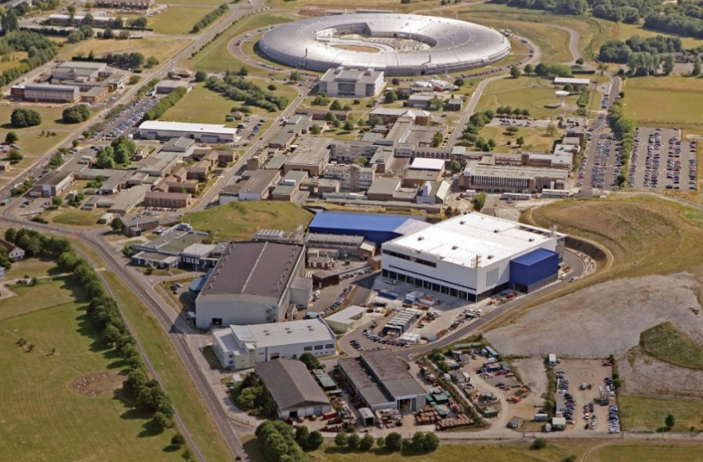
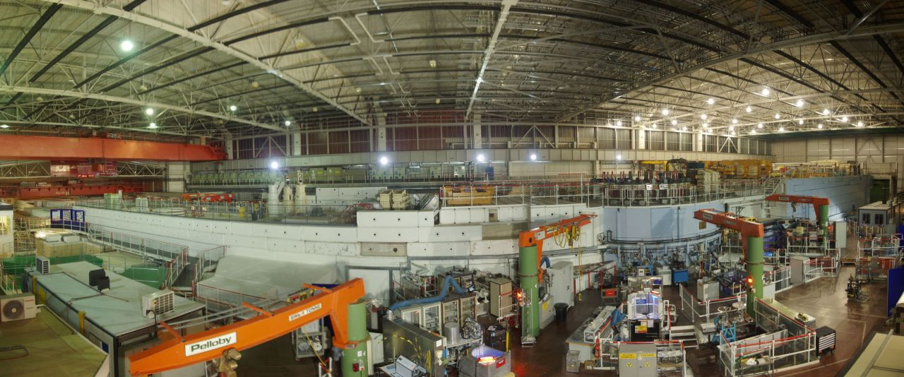
What is Neutron Scattering?
Notes:
But first Ross will explain a little bit about what neutron scattering

Slide 3
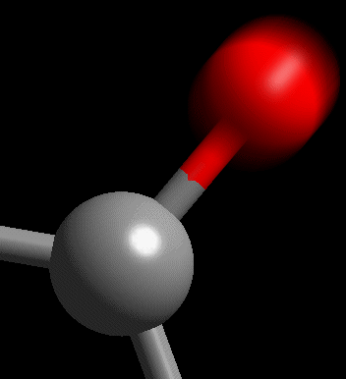
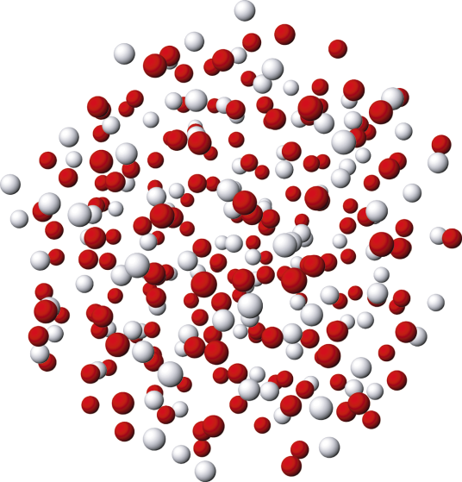
Neutron Scattering measures..
“where atoms are…’’ (atomic structure)
“what atoms do…” (atomic dynamics)
Notes:
So – ISIS is actually a giant microscope that can be used for studying what atoms are doing at the small scale inside substances. We say that ISIS is very good at looking at ‘where atoms are’ – so that’s about discovering how they are arranged deep inside substances – and ‘what atoms are doing’ – that’s about learning how atoms are moving and the forces between the atoms.

Slide 4
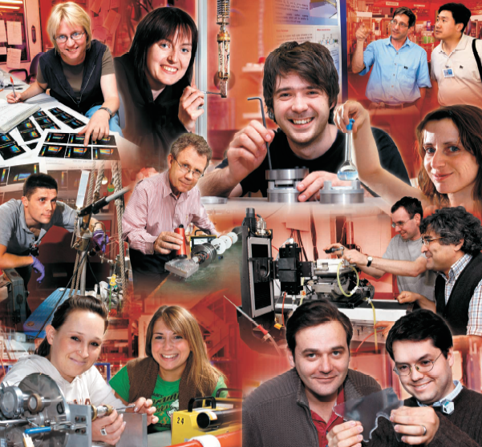
Neutron Scattering in the UK
Every year:
1100 proposals
800 experiments
~3000 researcher visits
from 30 different countries
1300 individual researchers
400-450 research publications

Slide 5


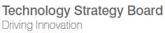
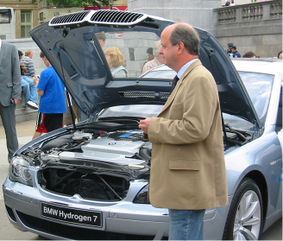
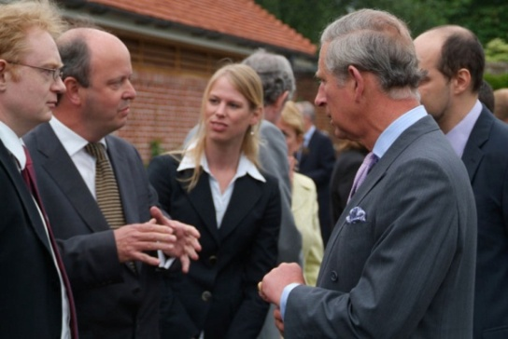
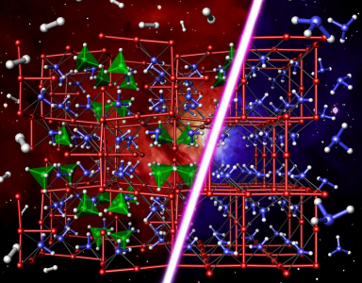
“We’ve discovered new sets of materials that can store hydrogen more efficiently than hydrogen itself. Neutrons are without doubt the best way to see hydrogen entering and leaving in real time.”
-Professor Bill David, ISIS Senior Scientist
Energy: improved hydrogen storage

Slide 6

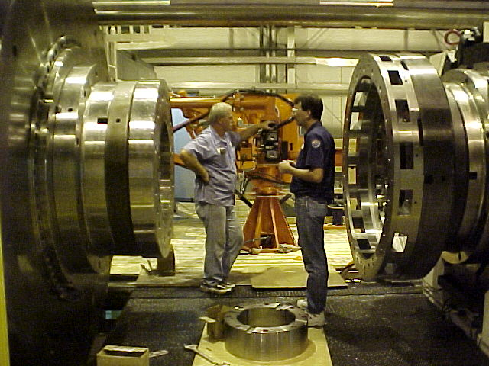
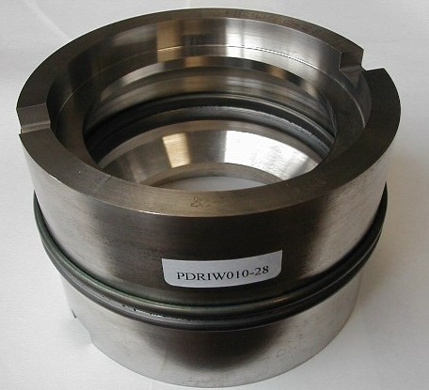

P. Withers, M Preuss, et al.
Prototype welded ring
Rolls-Royce plc. Compressor rotor factory (CRF)
As welded
Conventional PWHT
Modified PWHT
1500 MPa
5h 760°C
5h 810°C
unacceptable
Rolls Royce: studies of welding processes

Slide 7
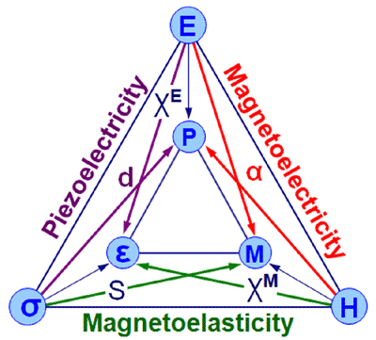


Applications

Slide 8
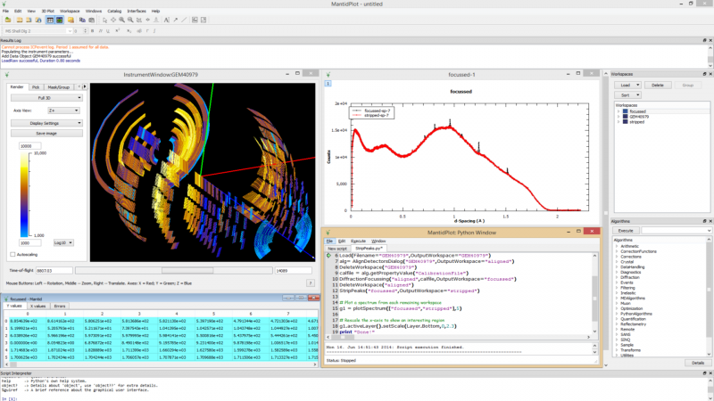
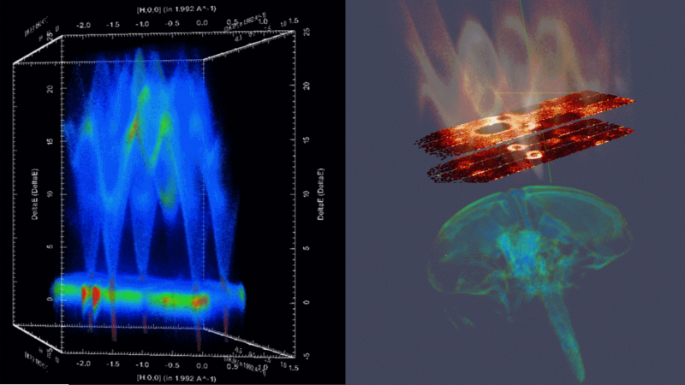
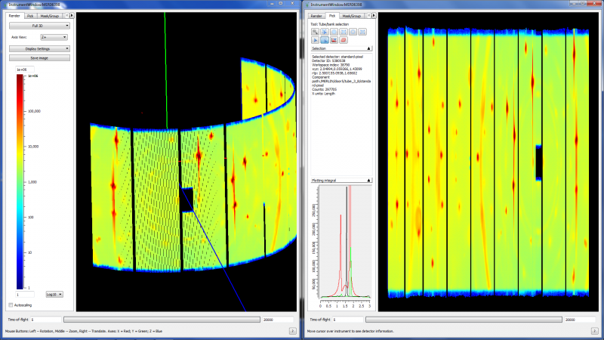
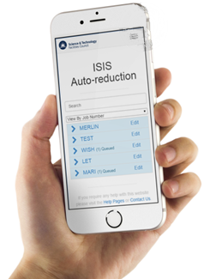
The Mantid Project
Notes:
So Neutron scattering is very powerful, but without software to help understand the results of these large instruments they are worthless

Slide 9
Project Goals
Goals
Consolidate the data reduction/analysis software for neutron scattering experiments
Without restricting the needs of the instrument scientists
Key requirements
Cross-platform
Easily extensible
Freely redistributable
Open source

Slide 10
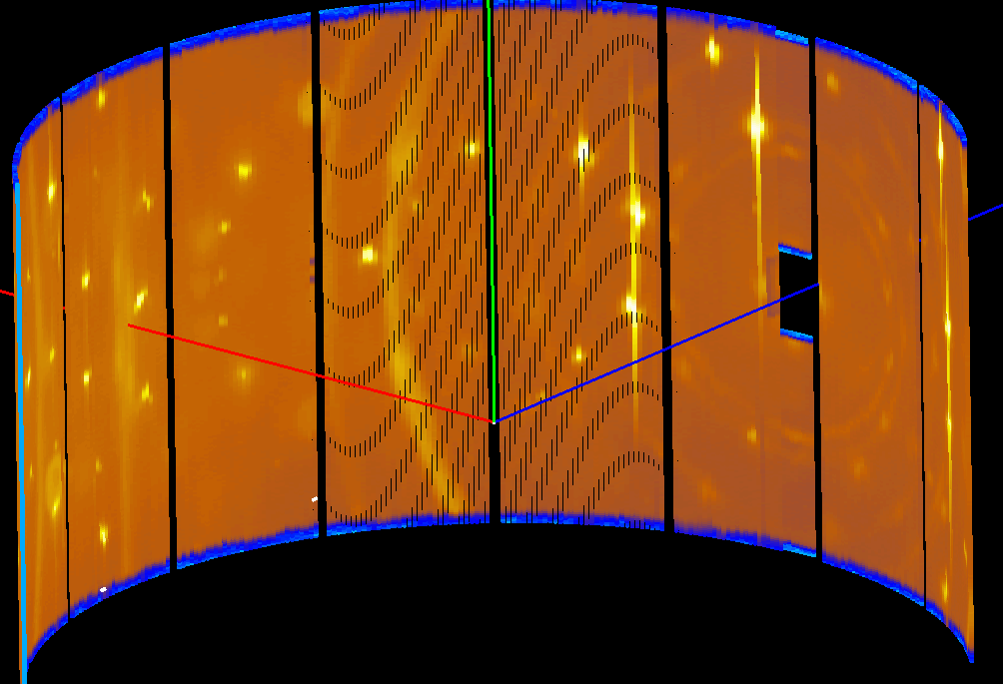
Scientific Data Flow
Raw Data
Time & Detector Coords
Useful for Diagnostics & Fault finding
Full of measurement artefacts

Slide 11
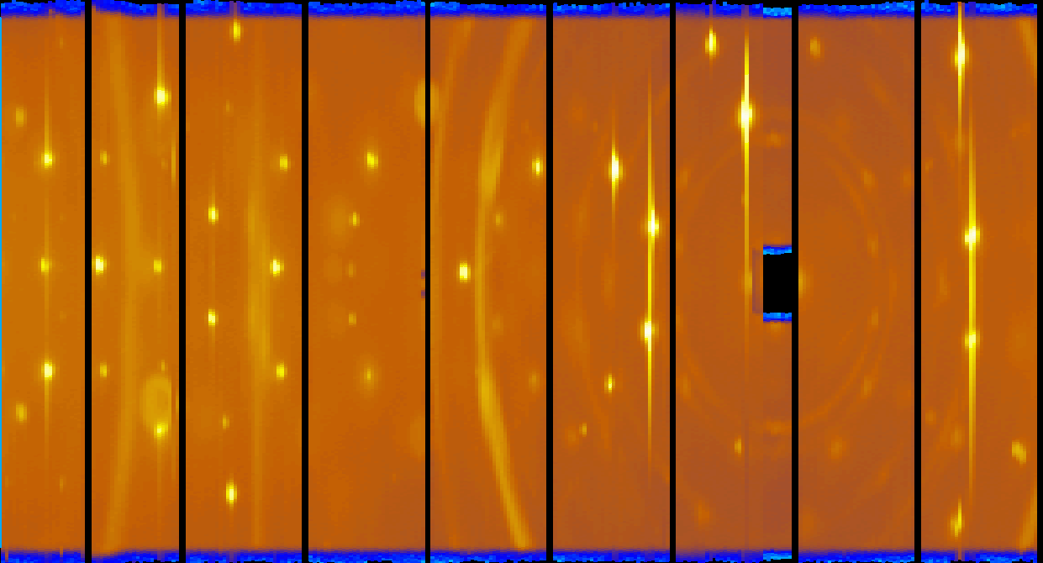
Raw Data
Merlin
256 x 272 = 70K Pixels
x 500 = 35M Pixels
x 5 incident energies
= 175M Pixels
256 Detectors
500 Time Channels
272 Tubes

Slide 12
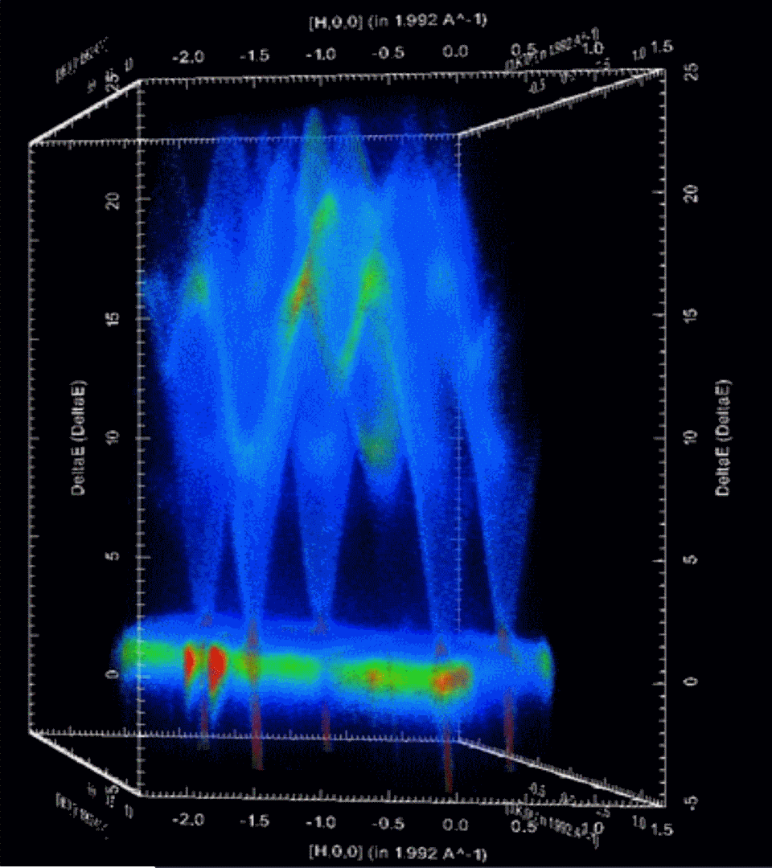
Scientific Data Flow
Raw Data
Time & Detector Coords
Reduced Data
Measurement artefacts corrected
Scientific Units
Useful for Diagnostics & Fault finding
Full of measurement artefacts
Size: compressed or expanded

Slide 13
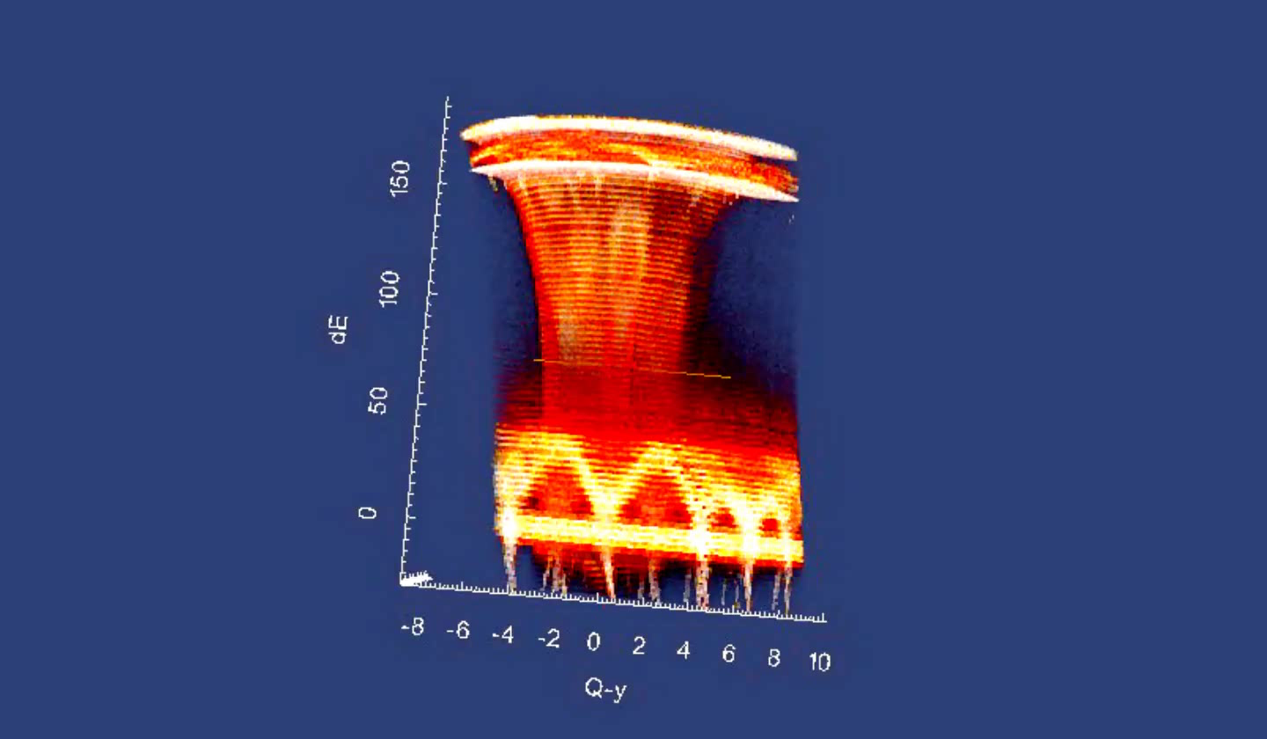
Multi Dimensional Visualization

Slide 14

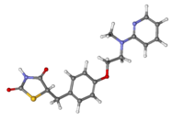
Scientific Data Flow
Raw Data
Time & Detector Coords
Reduced Data
Measurement artefacts corrected
Scientific Units
Data Analysis
Comparison with physical models
Extraction of understanding
Impact
Useful for Diagnostics & Fault finding
Full of measurement artefacts
Size: compressed or expanded
New materials
Process changes
Commercialization
Scientific Publication

Slide 15
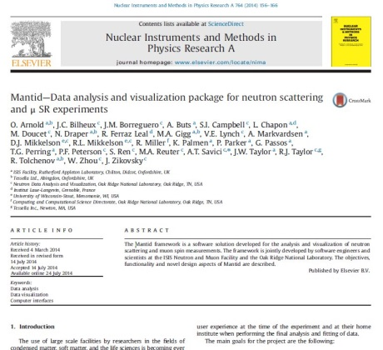
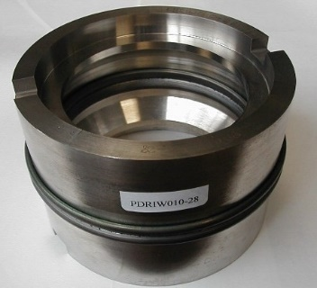
Scientific Data Flow
Raw Data
Time & Detector Coords
Reduced Data
Measurement artefacts corrected
Scientific Units
Data Analysis
Comparison with physical models
Extraction of understanding
Impact
Useful for Diagnostics & Fault finding
Full of measurement artefacts
Size: compressed or expanded
Commercialization
Scientific Publication
Process changes
New materials

Slide 16

Scientific Data Flow
Raw Data
Time & Detector Coords
Reduced Data
Measurement artefacts corrected
Scientific Units
Data Analysis
Comparison with physical models
Extraction of understanding
Impact
Useful for Diagnostics & Fault finding
Full of measurement artefacts
Size: compressed or expanded
Commercialization
Scientific Publication
Process changes
New materials
Visualization
Algorithms
Model Fitting & Optimisation
Live Data

Slide 17
Some Users
Most Users
Flexible user interface
Python Scripting
Technique specific interfaces
Point and click interface
Training & Examples
Super Users
Plug ins
Python Algorithms
Custom User Interfaces
Detailed help
Data History
Powerful visualisations
Simple Graphing
Matching the users experience

Slide 18
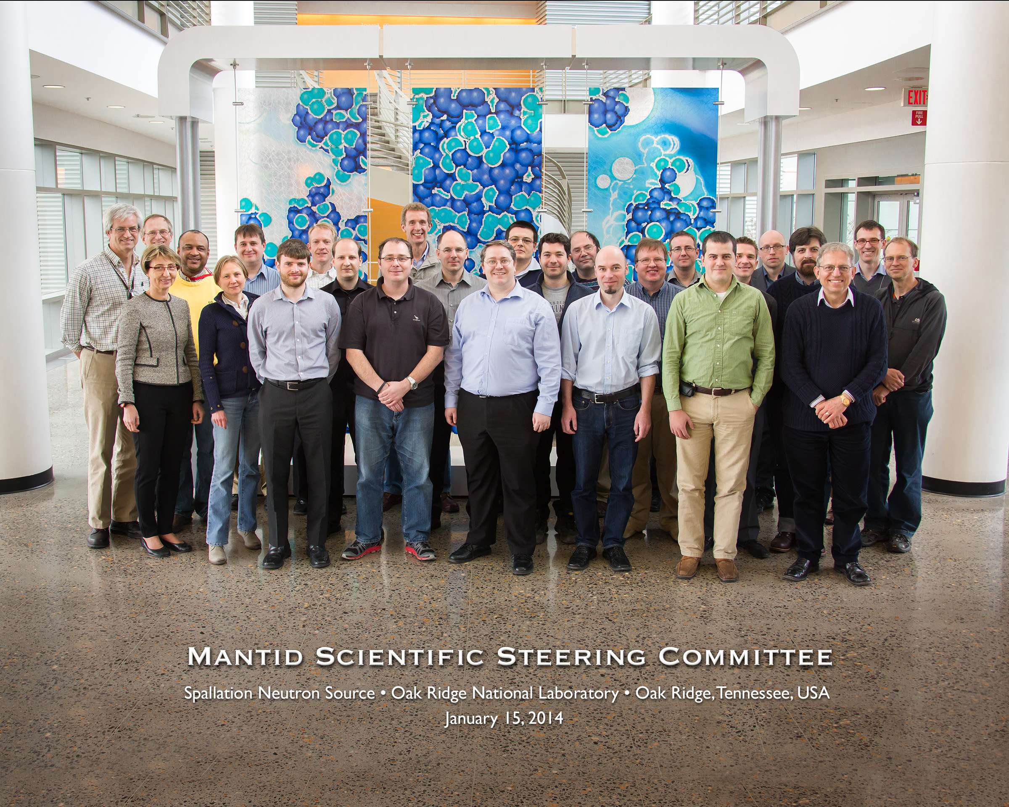
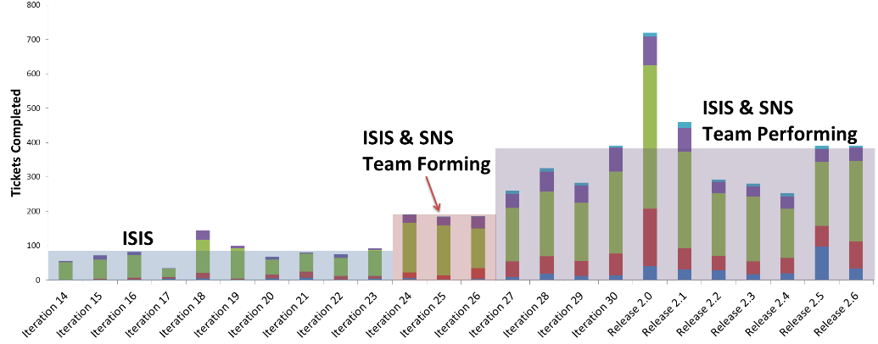
Professional development
Distributed Development Team
International Project Governance Board & Scientific Steering Committee
Dedicated software engineers
All with science BSc, many with PhD
Working closely with Instrument Scientists
Build and testing automation
20+ build servers
World class static code analysis
8,500 unit tests
300 automated system tests
Comprehensive documentation
675 automated tests on included scripts
Both online and installed with Mantid

Slide 19
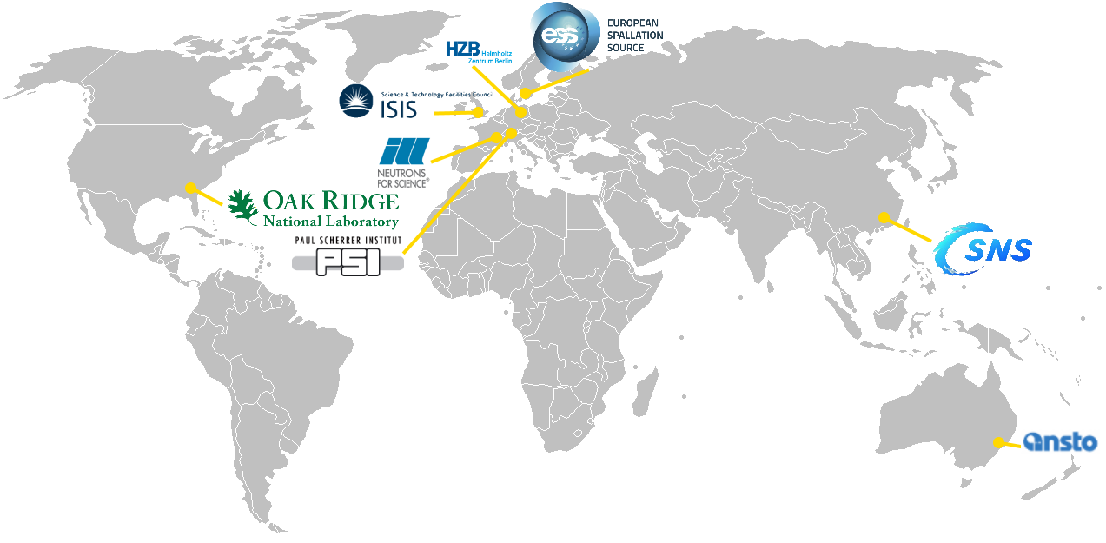
An outstanding international collaboration
Notes:
From it’s beginning at ISIS, Mantid has grown to an international collaboration with the Oak Ridge National Lab in the United States, and the European Spallation Source being Built in Sweden.
The Chinese Spallation source undergoing construction has also announced that it will be using Mantid as well, making that 4 out of 5 of the worlds pulsed neutron spallation sources.
Many of the Reactor based neutron sources are starting to use Mantid on individual efforts with the world brightest Neutron source the ILL planning on joining the collaboration next year.

Slide 20
Benefits
Scientists can concentrate on their science
Consistent user experiences within and across facilities
Performance & flexibility for new instruments / experiments
Robust reliable software
Comprehensive documentation
Built collaborations between facilities
“Mantid is the leading solution for neutron scattering data reduction”
- Mark Johnson, ILL

Slide 21
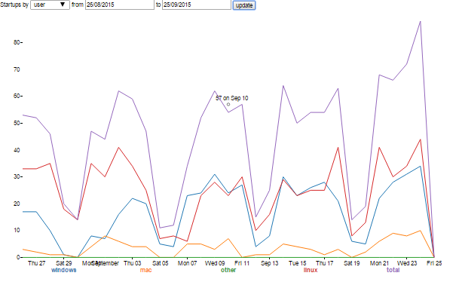
Usage
http://reports.mantidpoject.org

Slide 22

Benefits of Collaboration
A facility alone can provide these needs
Although many are not used to devoting their resources toward software developments.
Working together can be more productive than the sum of the parts.

Slide 23
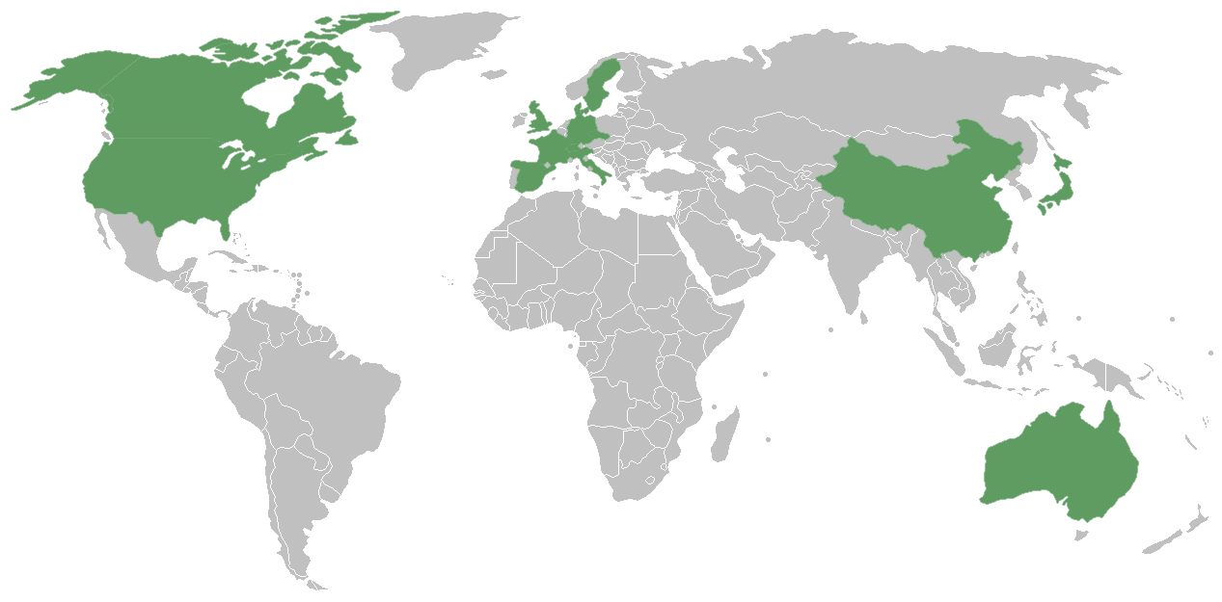

Mantid Training
Notes:
We now offer a whole range of self paced and taught training both in the UK and the United States.
And scientists from a wide range of Europe, the US and even China, Japan and Australia have travelled over to learn about Mantid.

Slide 24





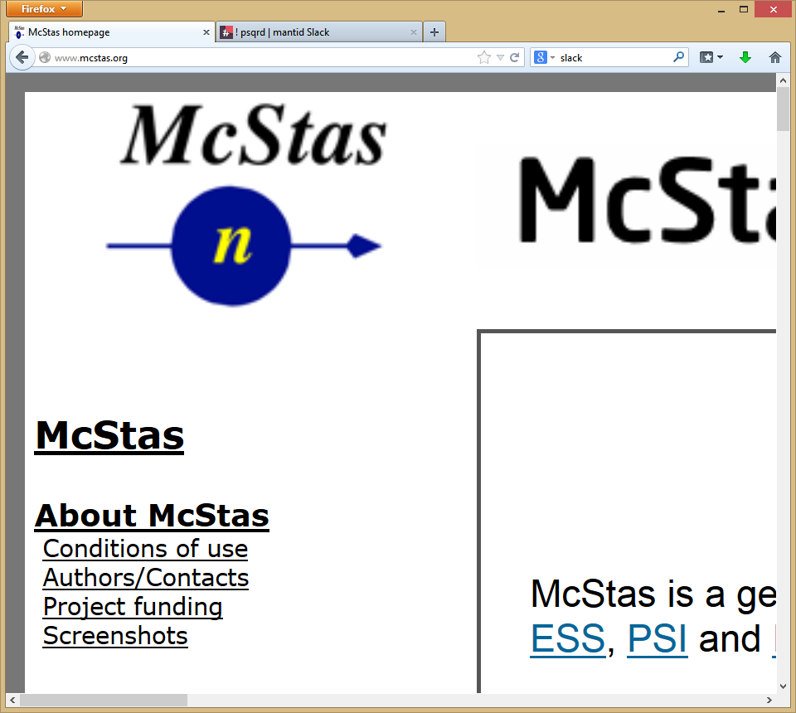


Contributors
Partners
Prime Contractor
Contributors

Slide 25
Contributions
ISIS
SNS
ESS
Robust framework
Extensible plugin design
Multithreaded performance
Documentation
Training
Automated build, test and deployment
Algorithms
Many already developed
Event Filtering and data analysis
Improvements to build process
Cmake, Jenkins
Improved python code framework
Autoreduction system
New file formats
NxSPE
Event Nexus
Paraview, Kitware contract, VSI
Live Data Focus
Performance Optimization
More to come …

Slide 26
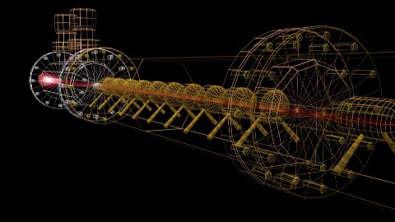
Neutron scattering

Slide 27
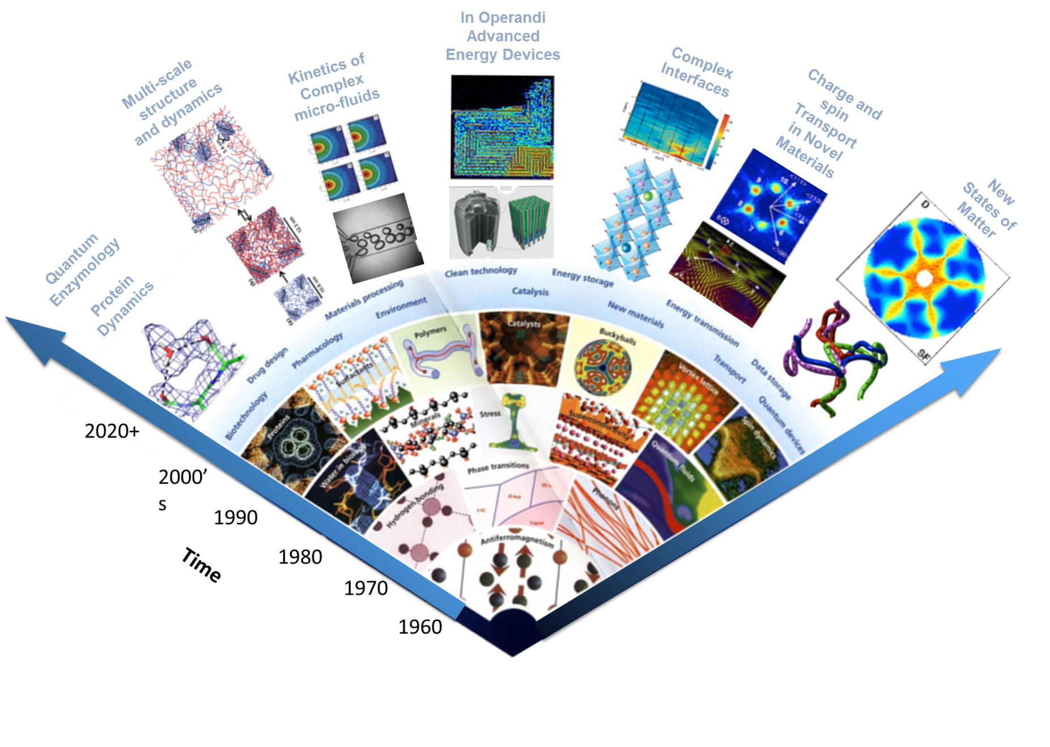
Illuminating Materials Science

Slide 28
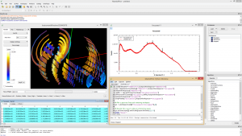
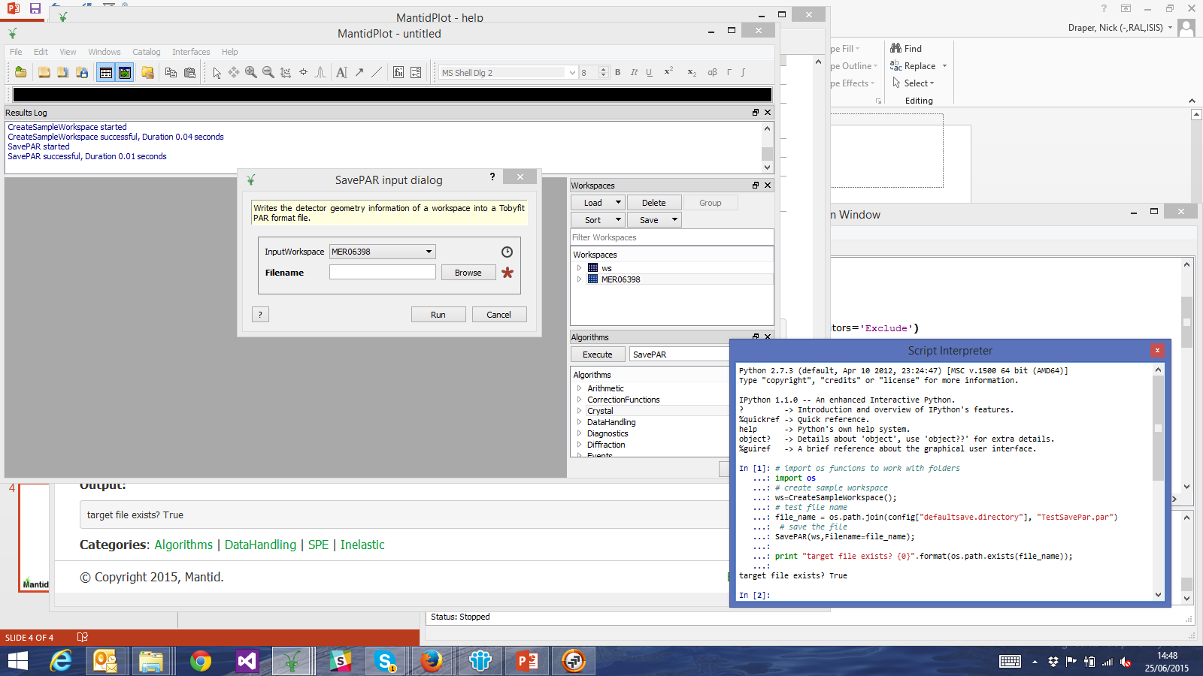
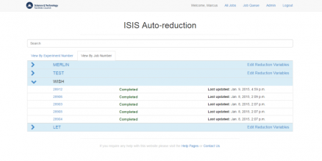
Architecture
Algorithms
Corrections
Input / Output
Support Services
Live Data
Model Fitting
Workspaces
Data
Sample Info
Instrument Geometry
Transforms
Diagnostics
Filtering
Simulation
Technique Specific
API

Slide 29
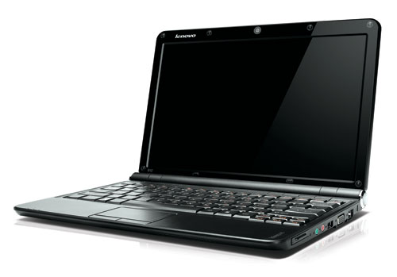
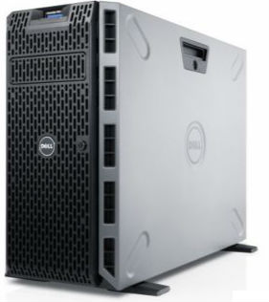
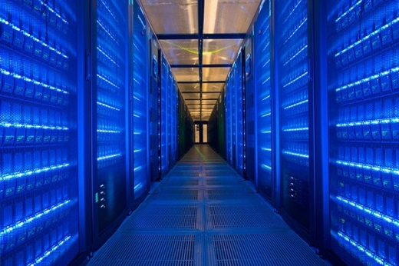
Data Processing Challenge
At ISIS
28 Instruments
Largest of which produces 40GB / day
Data Processing is complex and varied
Beam time is expensive
At ESS
New facility undergoing construction
LOKI will produce 1GB per second

Slide 30
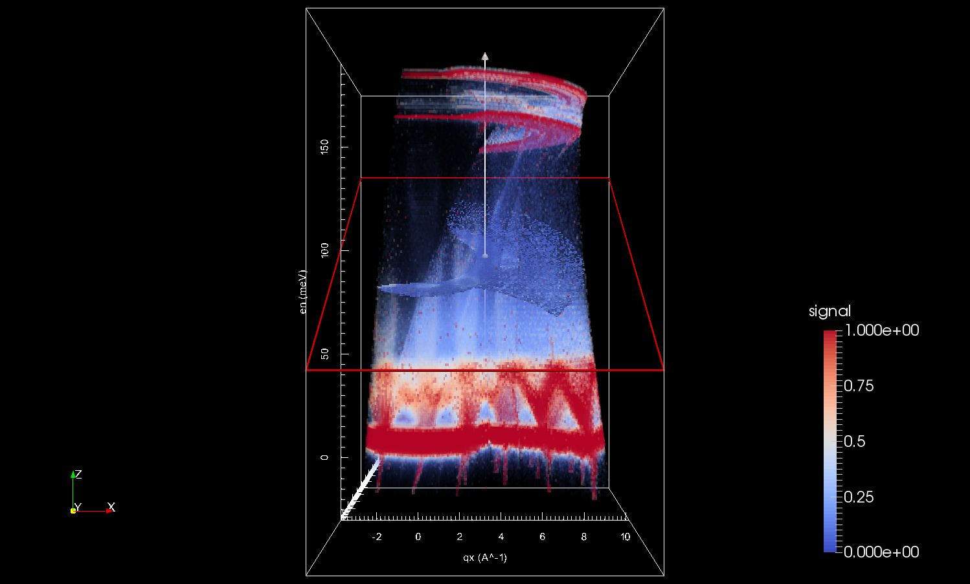
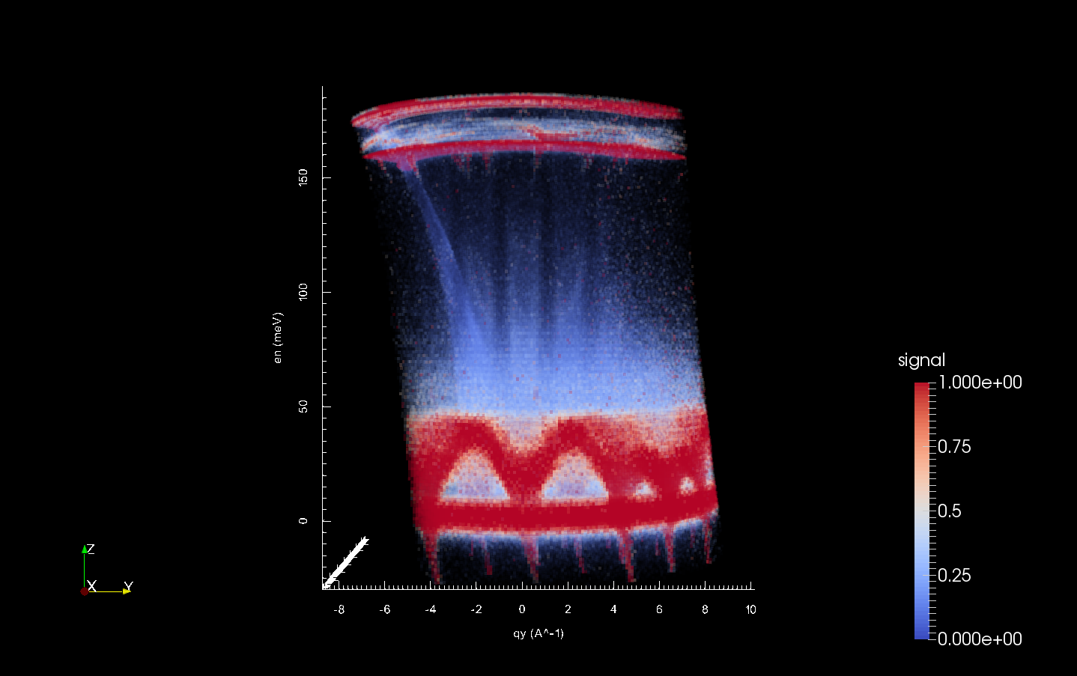
Multi Dimensional Visualisation
Fe 200Ei 8K

Slide 31



An outstanding international collaboration

